Slide 1
Data/Code driven UI using WPF part 2
Building own controls
Wolfgang Riedmann wolfgang@riedmann.it
Xbase.Future 2018 in Köln

Slide 2
Q & A
Is it possible to accomplish that using XAML, without writing code?
It should be possible, but IMHO less elegant and leass readable
Are there better solutions than the presented ones?
For sure there will be different solutions, and maybe some of them are better.
A different naming would be more precise
If you prefer other names for classes and properties, please change them as you like.
Can these controls be used also in XAML windows?
For sure they can, I have only omitted this in my samples
Can I use and modify these samples?
Of course you can! You can change them, but please don‘t take them as base for commercial controls. That means you can sell applications using these, but you cannot sell the controls itself.
Xbase.Future 2018 in Köln

Slide 3
Building own controls in WPF
The WPF controls are not based on the Windows controls, but are written from scratch using DirectX and are completely vector oriented.
Most controls can contain other controls!
There are only few limits to the imagination.
For example: a button can contain a Grid or a StackPanel, and these can contain other controls.
If you like to have success with WPF controls, please forget anything you know about Windows GDI and let your imagination go!
Xbase.Future 2018 in Köln

Slide 4
WPF and Databinding
WPF without databinding is possible, and works well.
But you will loose many possibilities of clean programming if you don‘t use it.
Therefore you should implement databinding also for your own controls.
Implementation of databinding with XAML:
<TextBox Name="Participant" Text="{Binding Model.Participant}"</TextBox>
Implementation of databinding using code:
oTextBox:SetBinding( TextBox.TextProperty, Binding{ „Model.Participant“ } )
When implementing own controls the databinding is the most of the work!
Xbase.Future 2018 in Köln

Slide 5
The ImageTextSelector
Xbase.Future 2018 in Köln
Notes:
I have built this control because I needed a control where to select a product option using an image and text.

Slide 6
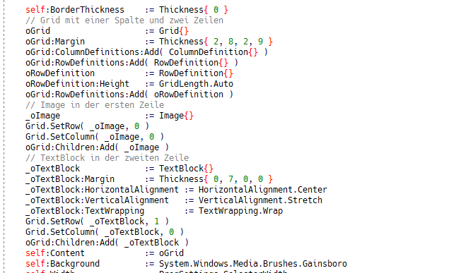
The Control
Xbase.Future 2018 in Köln
Notes:
The control is composed of two different controls : as first there is the containing control that is used to show the items – the ImageTextSelector.
The internal control has more functionality. It inherits from the button class and contains a Grid. In the first line of the Grid there is an ImageControl, in the second one a TextBlock

Slide 7
Implementation of Databinding
Xbase.Future 2018 in Köln
Notes:
To implement the databinding a DependencyProperty is needed. It is implemented as static variable in the class and needs to be registered the first time a control of this class is created. And then a static method in this class that will be called at every change of the property is needed.

Slide 8
Particularities
WPF executes actions caused by button clicks or menu selection with a Command.
The ImageTextSelector permits the attribution of a command for the double click, maybe to close the selection window.
In the text control of the sample is displayed the text of the currently selected image.
This is accomplished by a double binding: the property of the ImageTextSelectors is bound to a Property of the ViewModels gekoppelt, and this one changes another property on the ViewModel, that is bound to the textbox.
Xbase.Future 2018 in Köln

Slide 9
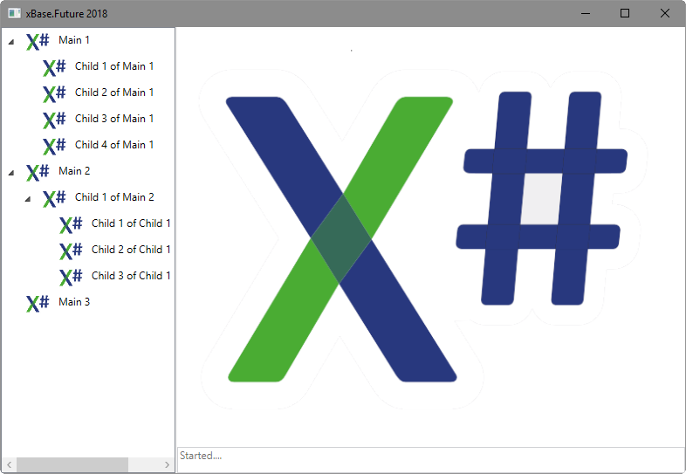
The TreeViewMenu
Xbase.Future 2018 in Köln

Slide 10
The Control
The TreeViewControl already has the complete display layout we need, included the databinding.
But: the TreeViewControl does not permits attibutions of commands to the different items, and the design of the single items is very limited.
Solution: you can use own controls as Treeview-Items.
Xbase.Future 2018 in Köln

Slide 11
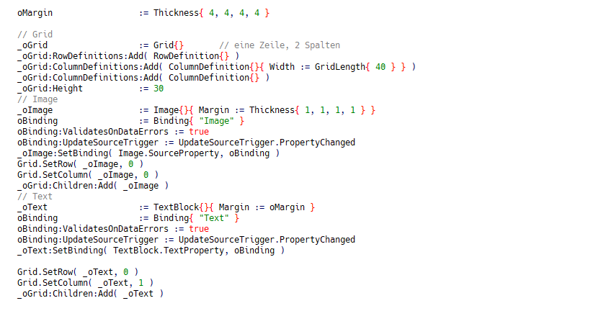
Das TreeViewMenuItem
Xbase.Future 2018 in Köln
Notes:
Der Inhalt des TreeViewItems („Header“) ist ein Grid, kann aber jedes beliebige ContentControl sein. Damit hat man jeden beliebigen Gestaltungsspielraum (siehe ProduktTreeView).

Slide 12
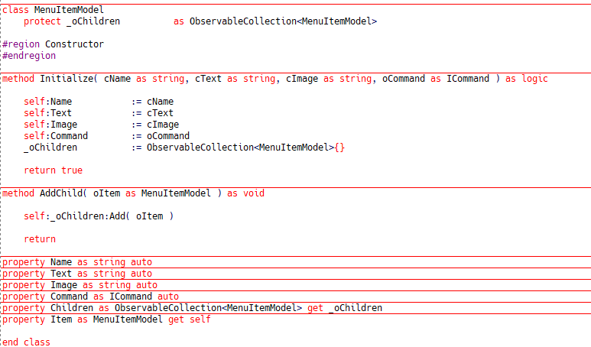
Important: the Model behind the Item
Xbase.Future 2018 in Köln
Notes:
Important: a Command for the button click, and then the data we need to display.

Slide 13
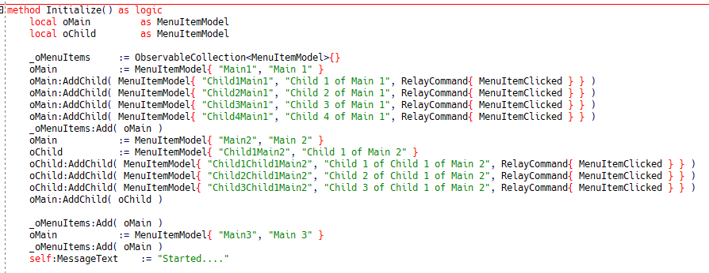
Filling through the ViewModel
Xbase.Future 2018 in Köln
Notes:
To keep the sample simple I have put the same command in every item. In a realworld application every item will have ist own command, maybe shared with menu items or buttons. Also in this sample: the selected item text is shown by a double databinding (from the control to the viewmodel and then back).

Slide 14
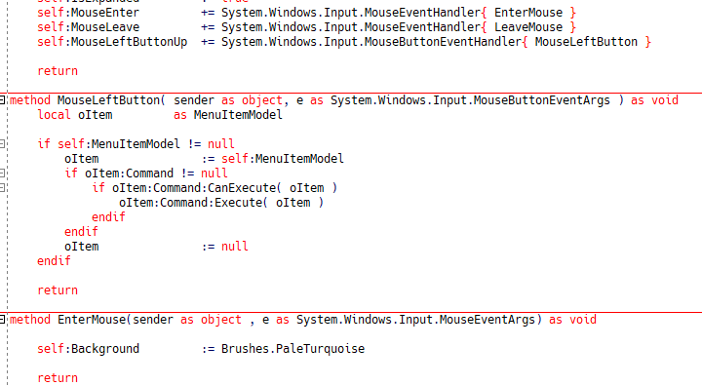
Trap the event
Xbase.Future 2018 in Köln
Notes:
Here: the MenuItem has a reference to the model (through Databinding), from which it executes the command and passes this to the command itself as parameter.

Slide 15
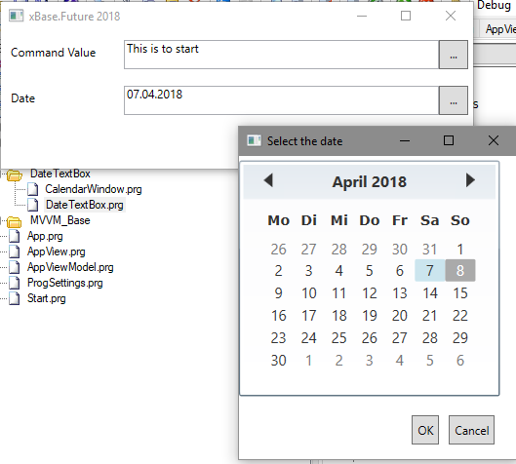
The DateTextBox
Xbase.Future 2018 in Köln
Notes:
It is possible to solve the date input in the pure MVVM style using windows and messages. But since a date selection is a very often used functionality, it may be better to define an own control for it.

Slide 16
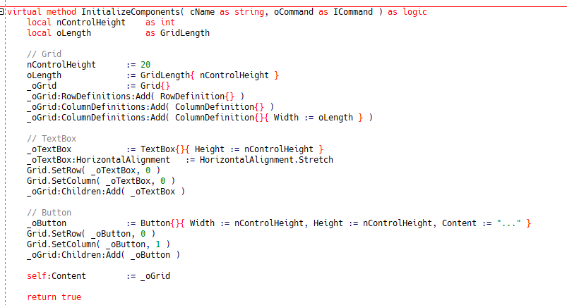
At half way: The CommandTextBox
Xbase.Future 2018 in Köln
Notes:
The CommandTextBox is a UserControl composed by a TextBox and a small button after it. A click on the button executes a command that can be set through databinding. Of course you can also set the content of the textbox through databinding. And is you need it you can add more properties to the control. In our sample the button will keep its quadratic form, changing the control height will also change the button width.

Slide 17
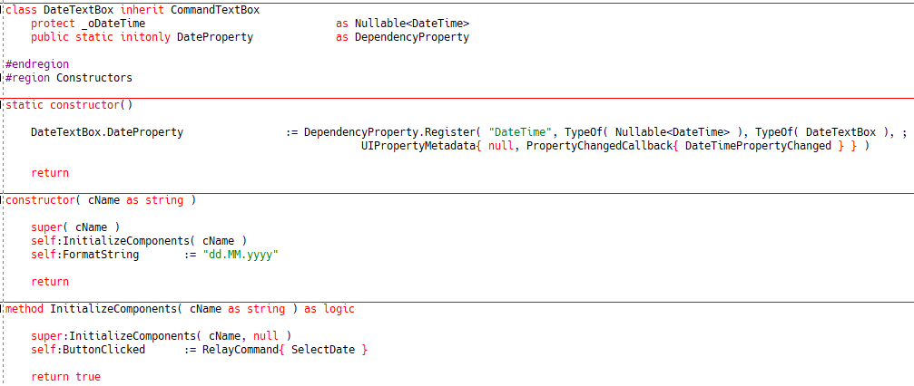
The DateTextBox
Xbase.Future 2018 in Köln
Notes:
For the DateTextBox we use the basic functionality of the CommandTextBox control inheriting from it. This saves an extra layout, and most of the functionality is taken over by the father class. We set only a Command and a FormatString property.

Slide 18
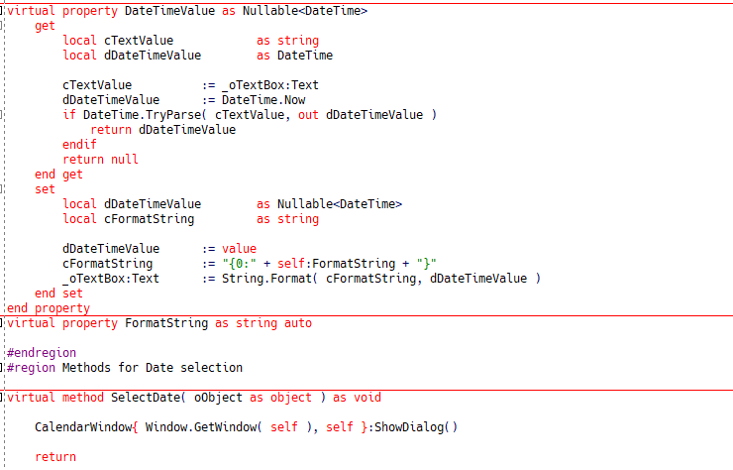
Implementation
Xbase.Future 2018 in Köln
Notes:
We make the conversion manually, so we have the control over this process, and we are independent from the system settings. The conversion is made betweeen String and Nullable<DateTime>. A normal DateTime cannot be null – empty dates are not possible with it!!!!
When the button is clicked, the calendar window is shown. This is ok also vor MVVM applications, since we are only in the view level. It would save some code to define an own button class.

Slide 19
Finished – Thank you for your attention!
Xbase.Future 2018 in Köln

